Slide 1
GH America Energy
https://GHAmericaEnergy.com info@GHAmericaEnergy.com
+1 (346) 998-2337
Land for 70 MW Solar & 70 MW | 140 MW BESS
“Investors commented that supply chain constraints, interconnection queue delays, and insufficient transmission capacity create significant risk challenges. These challenges can lead to delays in deal flow, longer lead times, and increased project costs.” ACORE-Expectations-for-Renewable-Energy-Finance-in-2023-2026.pdf
However, GHAE Rodeo Ranch Land is Ready to Connect.

Slide 2
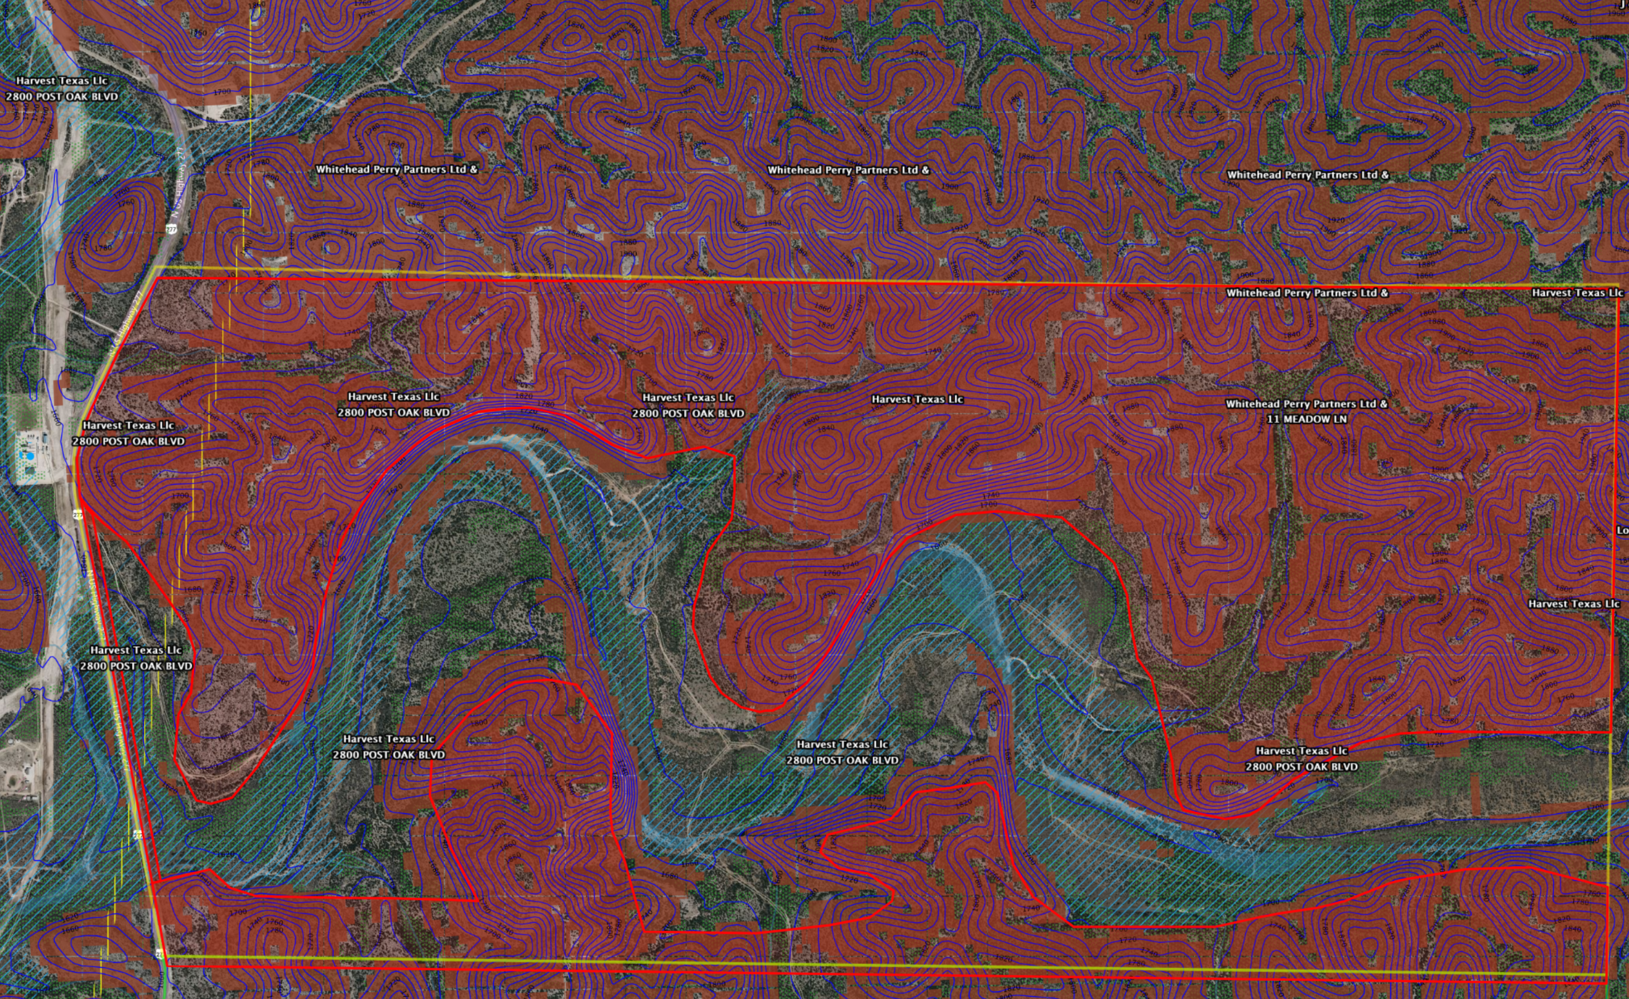
GHAE: Rodeo Ranch Land
Land for 70 MW PV Solar & 70 MW / 140 MWh BESS
½ Mile North is the 138 kW Substation & Maxwell Transmission Line
Upper Rodeo 1520ac
10ac Access Road off Hwy 277
Nearby Gas Pipeline / Terminal for ERCOT 400 MW Peaking Projects
Lower Rodeo 470ac

Slide 3
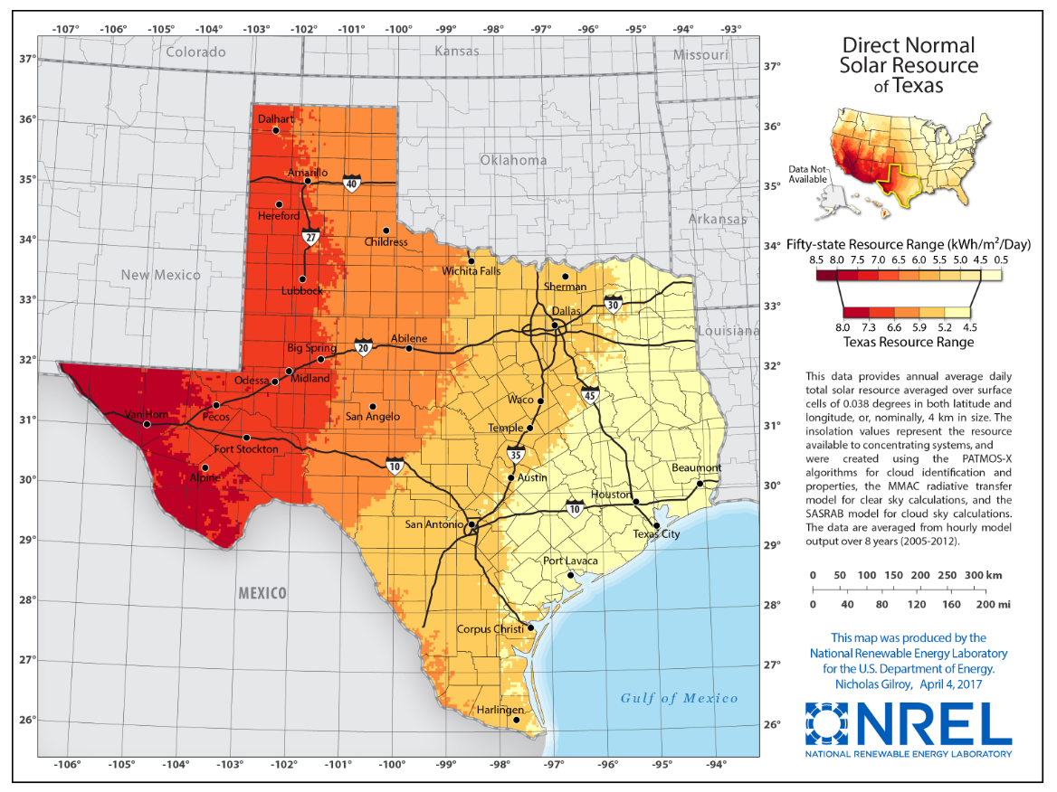
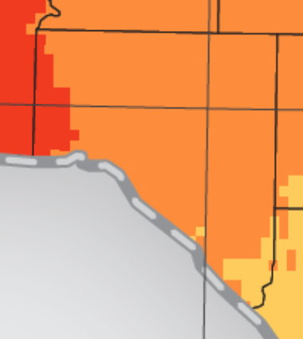
GHAE: Energy & Transmission
Rodeo Ranch Solar Energy & Power Transmission Resources
Transmission Upgrades
Hamilton Maxwell Line
AEP will upgrade the Hamilton Maxwell Transmission Line (with connection towards CPS Energy San Antonio) with 29 miles of new 138-kilovolt (kV) power line. This project is endorsed by ERCOT who oversees the Texas electrical grid. Completion date is by 2026.
Hamilton Picacho Line
AEP will upgrade the Hamilton Picacho Transmission Line (with connection across Del Rio) with 8 miles of new 138-kilovolt (kV) power line. This project is endorsed by ERCOT who oversees the Texas electrical grid. Completion date is by 2026.
Val Verde County
6.0 to 6.5 kWh/m² Moderately High Irradiance w Few Cloudy Days.
Two Irradiation Met Towers Monitoring 2+ Years.
Solar Resource Feasibility Studies Completed.
Desktop GeoTech Assessments Completed.
AEP is upgrading substation & lines south of the Rodeo Ranch:
Hamilton Road - Maxwell Transmission Line Rebuild Project (aeptransmission.com)
Hamilton Road - Picacho Transmission Line Project (aeptransmission.com)
ERCOT Solar & BESS MW Availability Forecast under Refreshment to included Effects of AEP Hamilton Substation & Lines Improvements.

Slide 4
GHAE: PV Reference Design
PV Solar Farm Reference Design: 2.4 MW Block Design
16 150kW Inverters
5,825 545W Modules
2.4 MWac Transformer
2.4 MWac Block Design
2.4 MWac | 3.2 MWdc | 1.32 Ratio Block
Single Axis Track 0.35 GCR w 60° Rotate
15.4 Acres for 3.175 MWdc PV Array
545W Modules into 16 150kW Inverters
NREL 11.5% DC & AC Losses Included

Slide 5
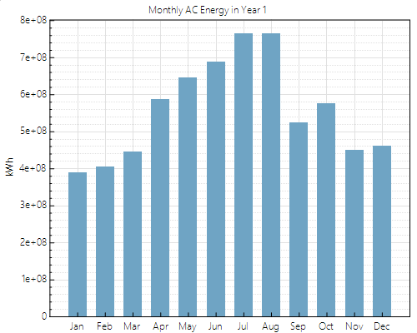
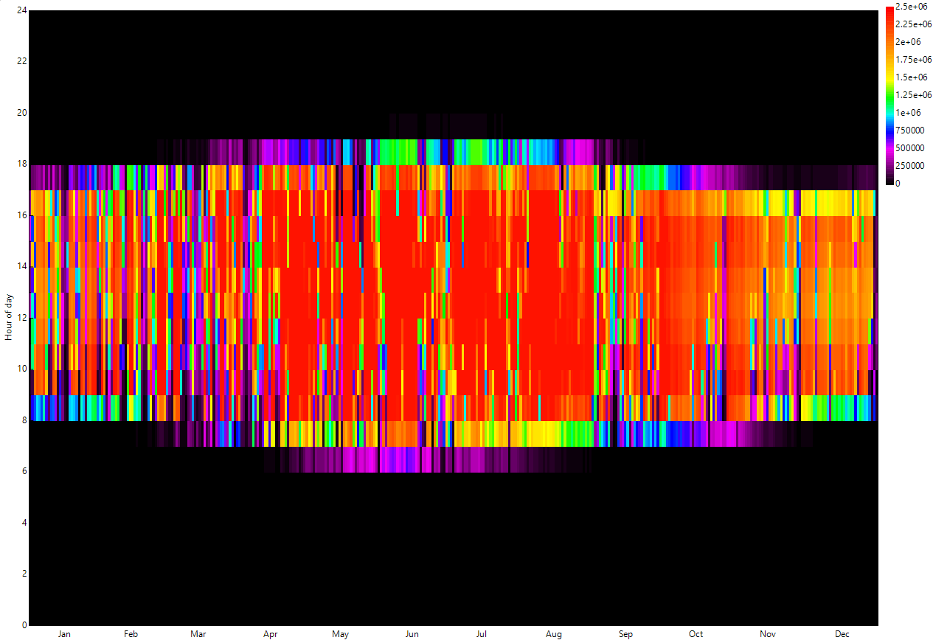
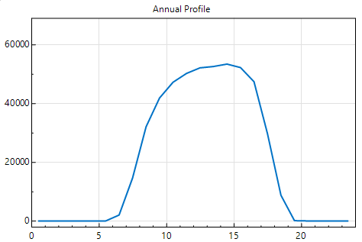
GHAE: PV Production
Solar Farm Reference Design: 29 Blocks of Production
PV Production and P90 8760
445ac PV Array
Nameplate 69.6 MWac | 92.1 MWdc
P90 (Year 2015): 176,633 MWh
P50 (Year 2009): 189,151 MWh
P10 (Year 2010): 194,137 MWh
P90 Production by Mo / Hr

Slide 6
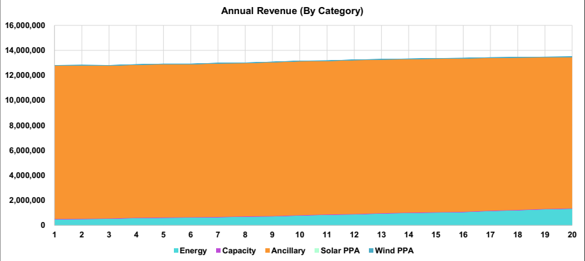
GHAE: BESS Production
BESS Reference Design: 70 MW 140 MWh Configuration
Day Ahead / Response Reserve
BESS Production
70 MWh | 140 MWh | 20ac
Year 1 Scenarios
Arbitrage + Spinning Reserve 0%:
Year 1 - 15 Cycles - $12,791,884
Arbitrage + Spinning Reserve -5%:
Year 1 - 15 Cycles - $11,060,988
Arbitrage + Spinning Reserve -10%:
Year 1 - 15 Cycles - $9,632,412
First Year Revenue

Slide 7
GHAE: realizing Rodeo
GHAE Refreshing Interconnection MW Availability …
To Attain More MWs in Less Time with Less Upgrade Costs,
Identify Available MWs at the Substation & Line for 2026.
Submit Phase I BESS & Solar Applications, and complete BESS Installation and Operation in 18 to 24 Months.
After BESS is in Operation, move on to complete Solar Construction and Operation from Month 24 to 48.
During Phase I BESS Application, determine Future Additional MW Availability beyond 2026 and Submit Phase II BESS & Solar Applications to build after completion of Phase I.
Not Operating in Texas?
We can Perform Development on Your Behalf!

Slide 8
GH America Energy
https://GHAmericaEnergy.com info@GHAmericaEnergy.com
+1 (346) 998-2337

