Slide 1
GH America Energy
https://GHAmericaEnergy.com info@GHAmericaEnergy.com
+1 (346) 998-2337
Land for Green Ammonia/Methane Projects
“The global green ammonia market size is estimated to reach US$ 82.4 million in 2023. The market is projected to register a stupendous CAGR of 68%, driven by surging requirements for green ammonia from end uses like power generation and agriculture. The overall market is poised to attain a valuation of US$ 14,761.3 million by 2033.”
Green Ammonia Market Trend, Outlook & Forecast by 2033 | FMI (futuremarketinsights.com)

Slide 2
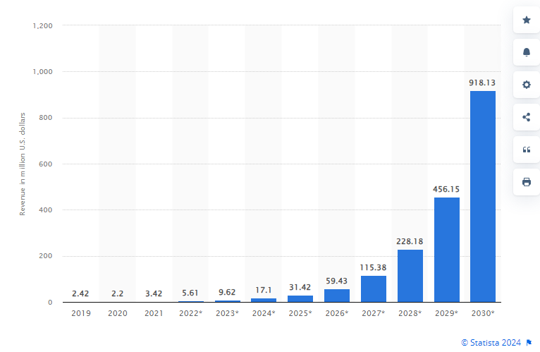
GHAE: usa ammonia market
USA Green Ammonia Market Growth Projection
Now is the Time to Invest

Slide 3
GHAE: necessary resources
Land, Water, Air & Energy for Green Ammonia Production
Wind
Separation
Air
Nitrogen
Haber-Bosch Processing
Green Energy
Green Ammonia
Electrolysis
Water
Hydrogen
Energy
Storage
Solar
Land
Aquifer
GHAE owns 32,000+ Acres of SouthCentral Texas Land.
GHAE Land sits atop Texas SouthCentral Edwards Trinity Aquifer.
GHAE Land has plenty of Dry Air above it in SouthCentral Texas.
GHAE Land offers +315MW Wind Energy and +2445MW Solar Energy.
GHAE Lands have a 138 kV Transmission Line running Through Them.

Slide 4
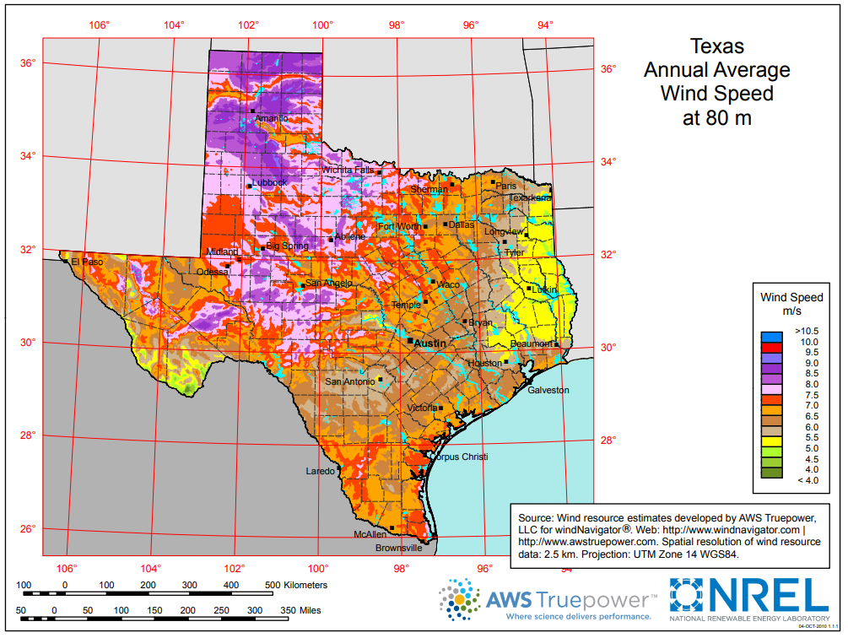
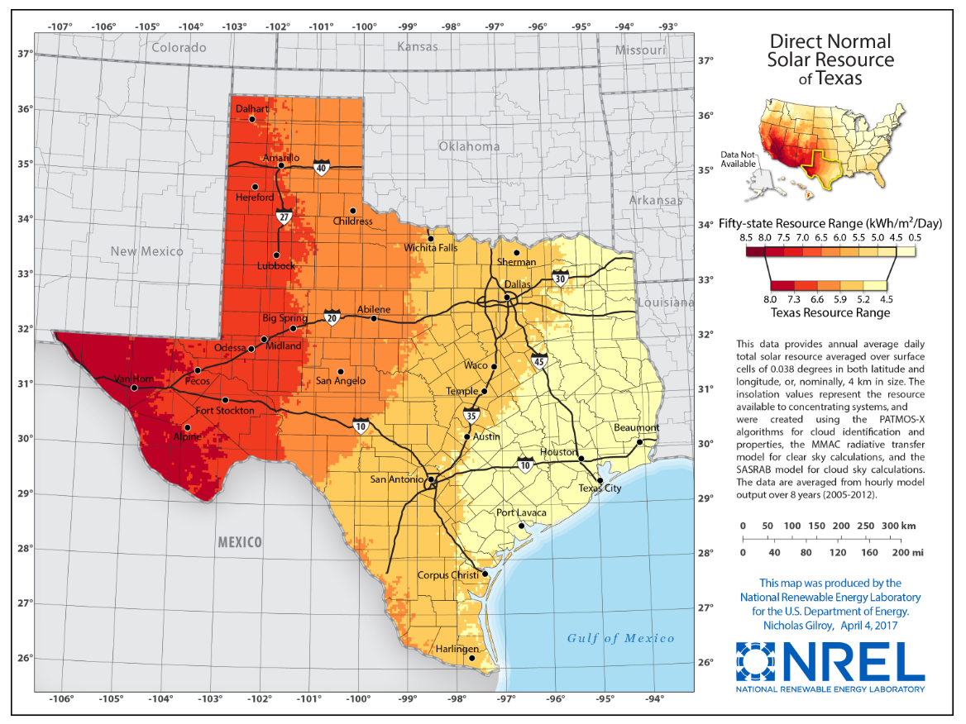
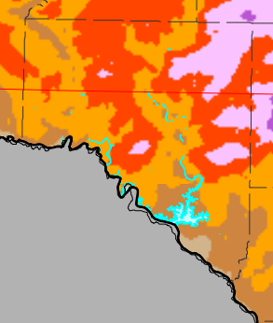
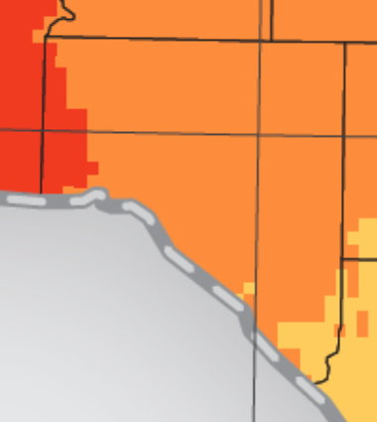
GHAE: green Energies
Texas Wind, Solar and Battery Energy Storage Resources
Val Verde County
Val Verde County
7.5 to 8.5 m/s Moderately High Speed @ Constant Duration.
Three Met Towers and Lidar Monitoring 3+ Years.
Wind Resource Feasibility Studies with Validation Report.
46 times 6 MW Turbine Layout Completed.
DOD/FAA/USAFB Flight Path Approvals Obtained.
6.0 to 6.5 kWh/m² Moderately High Irradiance w Few Cloudy Days.
Two Irradiation Met Towers Monitoring 2+ Years.
Solar Resource Feasibility Studies Completed.
Desktop Topology Assessments Completed.
DOD/FAA/USAFB Flight Path Approvals Obtained.
Texas is #1 in USA Wind Production as of 2023, and has been for 17 Years.
Texas is #2 in USA Solar Production as of 2023, and has been for 4 Years.
Texas will become #1 in USA Large Scale Battery Storage Production in 2024.

Slide 5
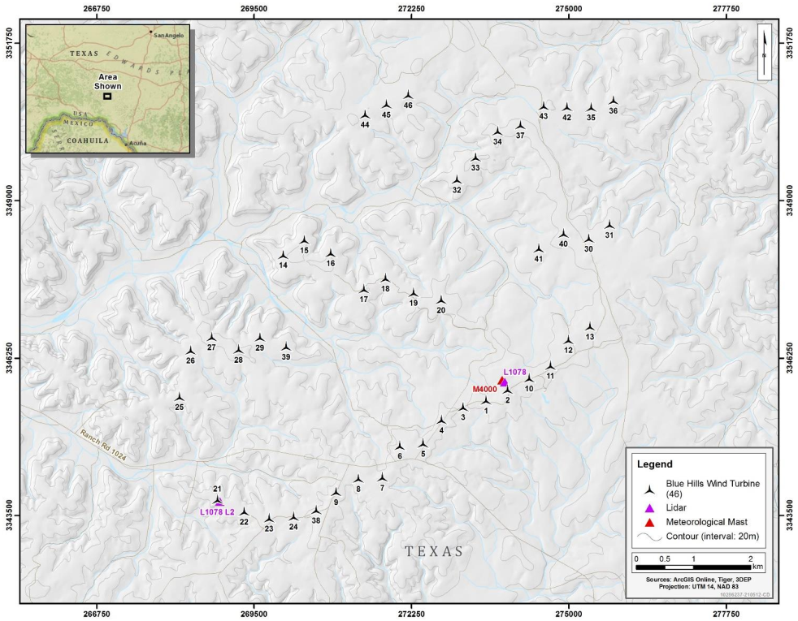
GHAE: Land, Water & Power
Texas Land, Water and Station Power Resources
+15,500ac of Wind Farm Land (Blue).
+16,500ac of Solar Farm Land (Yellow).
Edwards Aquifer running Under All Lands,
with Multiple Water Wells across Aquifer.
138kV Transmission Line across All Lands.
315MW Wind Turbine Siting Shown Below:

Slide 6
GHAE: Project Realization
GHAE Properties have All of the Necessary Resources in Plentiful Abundance for a Green Ammonia/Methane Project…
Acres and Acres of Land far from the Ranchland Neighbors while having a Major Water Aquifer Underneath.
High Amounts of Wind Resources with a Government Approved Wind Farm Reference Design that is Readily Deployable.
High Amounts of Solar Resources with Locally Available Solar Farm Engineering, Procurement & Construction Firms.
Multiple Sources for Battery Energy Storage Suppliers.
Station Power Transmission Line also available for use for ERCOT Renewable Energies Interconnection.
Not Operating in Texas?
We can Perform Development on Your Behalf!

Slide 7
GH America Energy
https://GHAmericaEnergy.com info@GHAmericaEnergy.com
+1 (346) 998-2337

Slide 8
GH America Energy
Wind Farm Reference Design

Slide 9
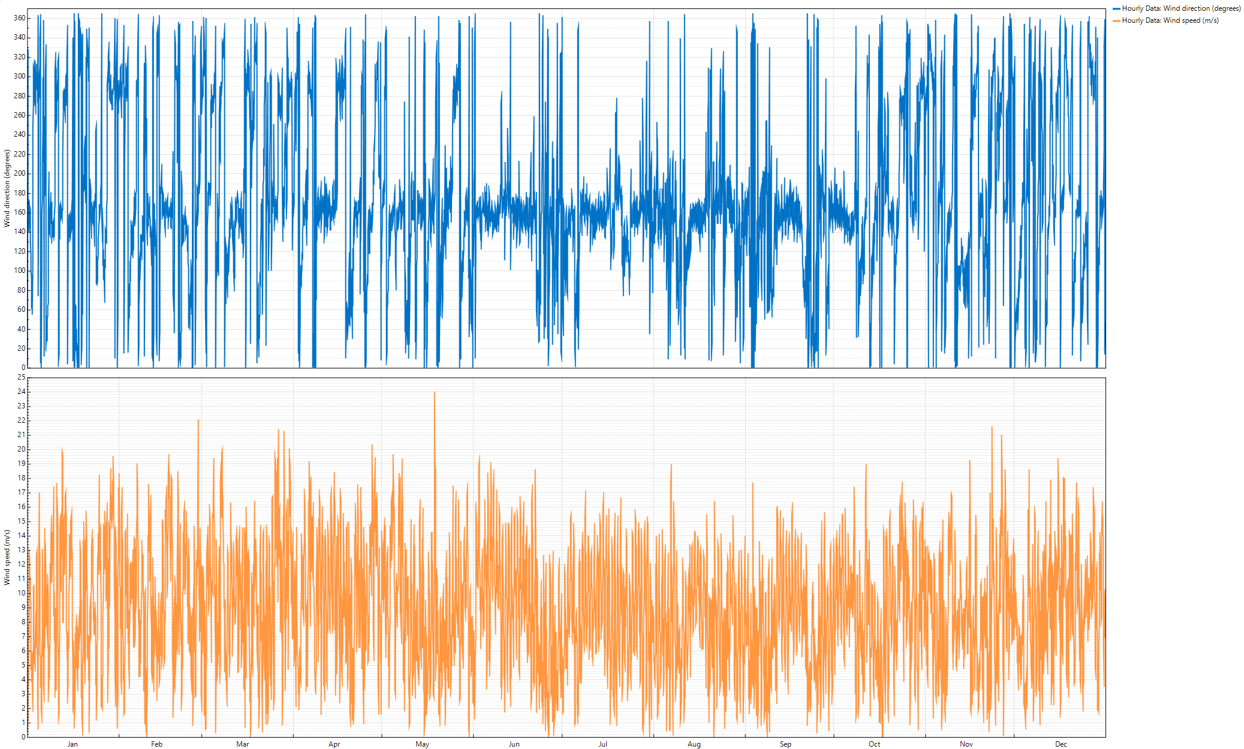
GHAE: Wind Farm Reference
Wind Farm Reference Design: Wind Resource Assessment
Wind Direction (Field Rotation 25°) and Wind Speed (m/s)

Slide 10
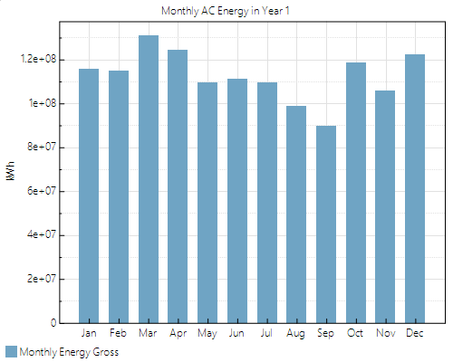
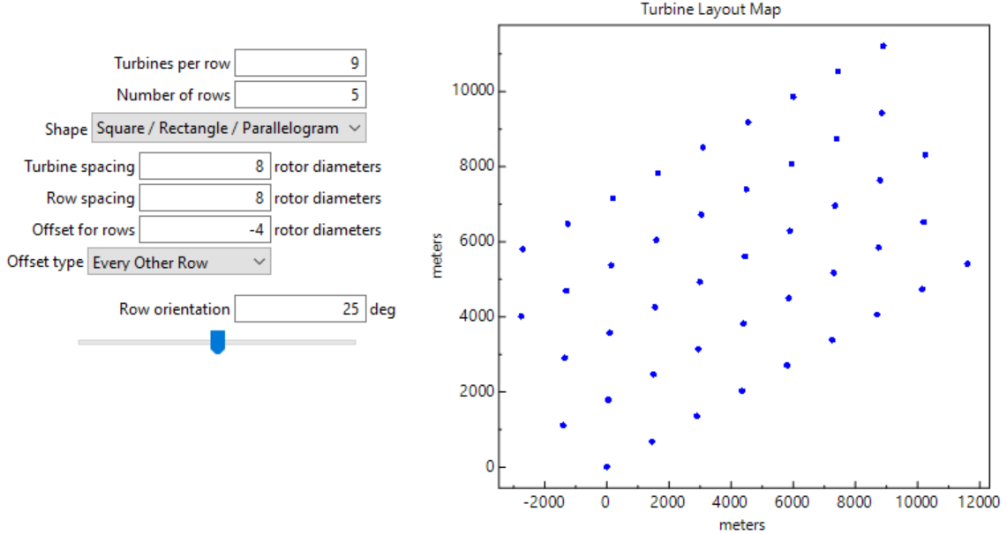
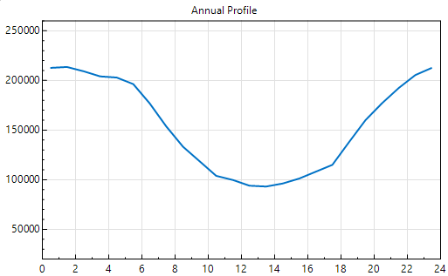
GHAE: Wind Farm Reference
Wind Farm Reference Design: Layout vs Blue Land Production
Turbine Layout Field Analysis
45 7MW Turbines | R200m | H120m
TS8RD | RS8RD | OFF4RD Every Other
NREL Ed-Vis TC0.1 | 11% Const Loss
NREL’s Avl, Elc, Prf, Env & Crt Losses
Name 315 MW | Prod 1,352,270 MWh
15,000m by 11,500m: 42,625 Acres
Blue Land Production

Slide 11
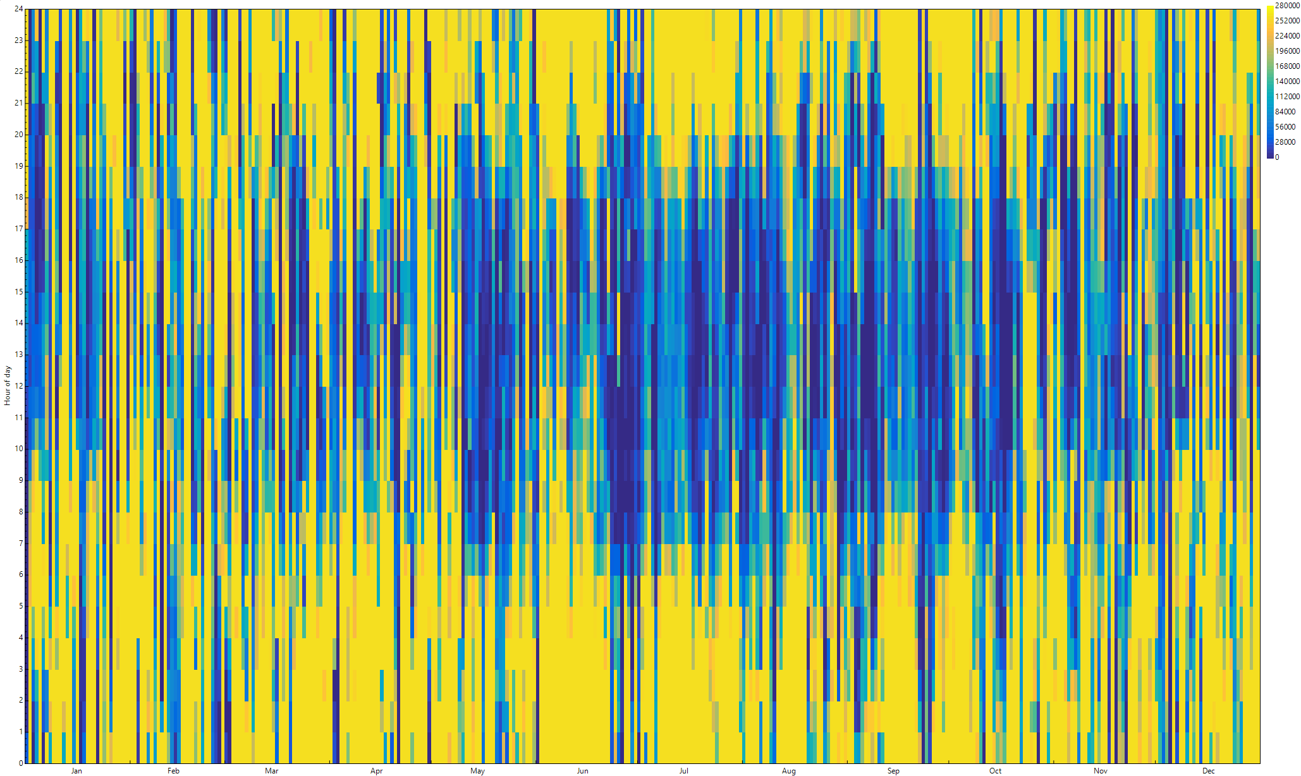
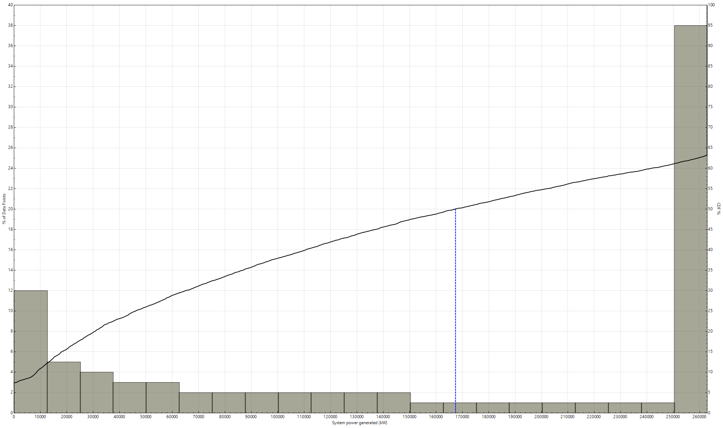
GHAE: Wind Farm Reference
Wind Farm Reference Design: Blue Land Production
Blue Land Annual Production
Met Tower Measurements,
Weather File Creations,
8760 Assessments
Production Probabilities
P10 / P50 / P90 Uncertainties,
P50 Histogram Below
P90: 8,608 kW Block
P50: 167,465 kW Block
P10: 262,851 kW Block

Slide 12
GH America Energy
https://GHAmericaEnergy.com info@GHAmericaEnergy.com
+1 (346) 998-2337

Slide 13
GH America Energy
Solar Farm Reference Design

Slide 14
GHAE: Solar Farm Reference
Solar Farm Reference Design: 2.4 MW Block Design
16 150kW Inverters
5,825 545W Modules
2.4 MWac Transformer

Slide 15
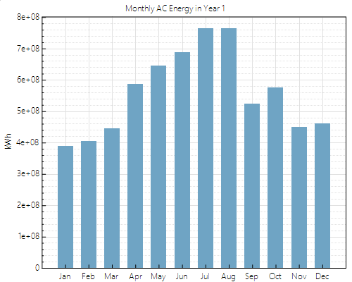
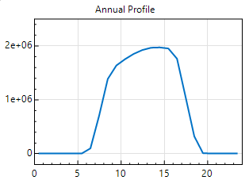
GHAE: Solar Farm Reference
Solar Farm Reference Design: Block vs Yellow Land Production
2.4 MWac Block Design
2.4 MWac | 3.2 MWdc | 1.32 Ratio Block
Single Axis Track 0.35 GCR w 60° Rotate
15.4 Acres for 3.175 MWdc PV Array
545W Modules into 16 150kW Inverters
NREL 11.5% DC & AC Losses Included
Yellow Land Production
15,664ac PV Array (95% of Yellow Land)
Nameplate 2,448 MWac | 3,237 MWdc
P90 (Year 2015): 6,212,590 MWh
P50 (Year 2009): 6,652,870 MWh
P10 (Year 2010): 6,828,250 MWh
Yellow Land Production

Slide 16
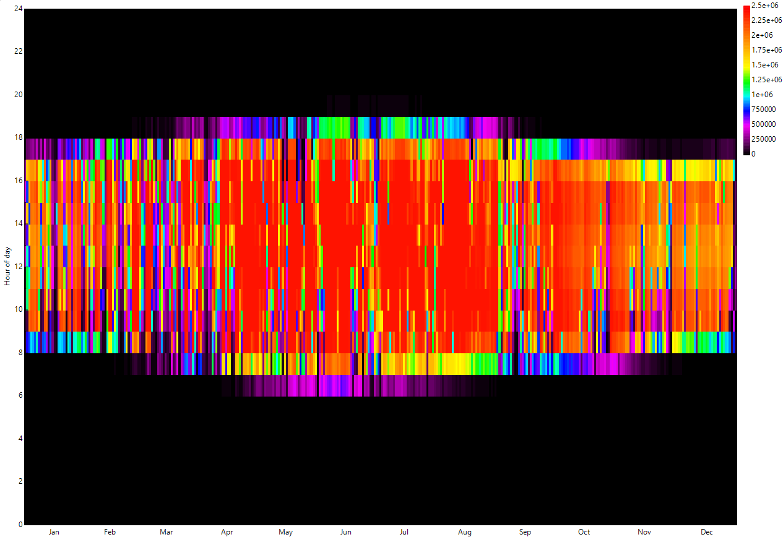
GHAE: Solar Farm Reference
Solar Farm Reference Design: Yellow Land Production
Yellow Land Annual Production
Yellow Land
Nameplate
2,448 MWac
3,237 MWdc
Yellow Land
Production
P90: 6,212,590 MWh
P50: 6,652,870 MWh
P10: 6,828,250 MWh

Slide 17
GH America Energy
https://GHAmericaEnergy.com info@GHAmericaEnergy.com
+1 (346) 998-2337

Slide 18
GH America Energy
Edwards – Trinity Plateau Aquifer

Slide 19
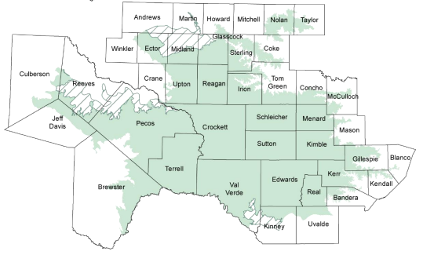
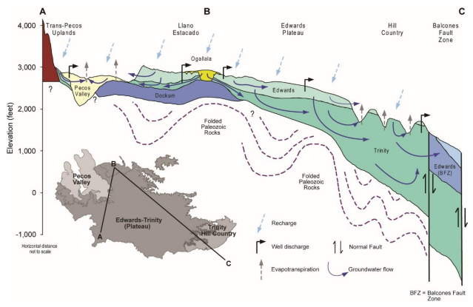
GHAE: Aquifer Reference
Edwards – Trinity Plateau Aquifer
Val Verde Groundwater
Area of Aquifer:
2,923 Square Miles
Average Annual Baseflow:
119.3 Cubic Feet / Second
Median Annual Baseflow:
62.3 Cubic Feet / Second
Val Verde Groundwater Levels
1995-2000: -5 to 0 Feet
2000-2005: 10 to 20 Feet
2005-2010: -20 to -10 Feet
2010-2015: -5 to 0 Feet
Texas Aquifers Study

Slide 20
GH America Energy
https://GHAmericaEnergy.com info@GHAmericaEnergy.com
+1 (346) 998-2337

