Slide 1


GH America Energy
https://GHAmericaEnergy.com
+1 (979) 583-1544
GHAE/BHP Properties for Manufacturing Plants with local Baseload & Renewable Power Supply
Best Solar, Wind, Gas & Water Resources for Manufacturing Plant with local Power Generation
Best PV/BESS PPA Pricing, Grid Interconnection, Transportation & Transmission Access
Best Location for Power Purchasing Projects

Slide 2
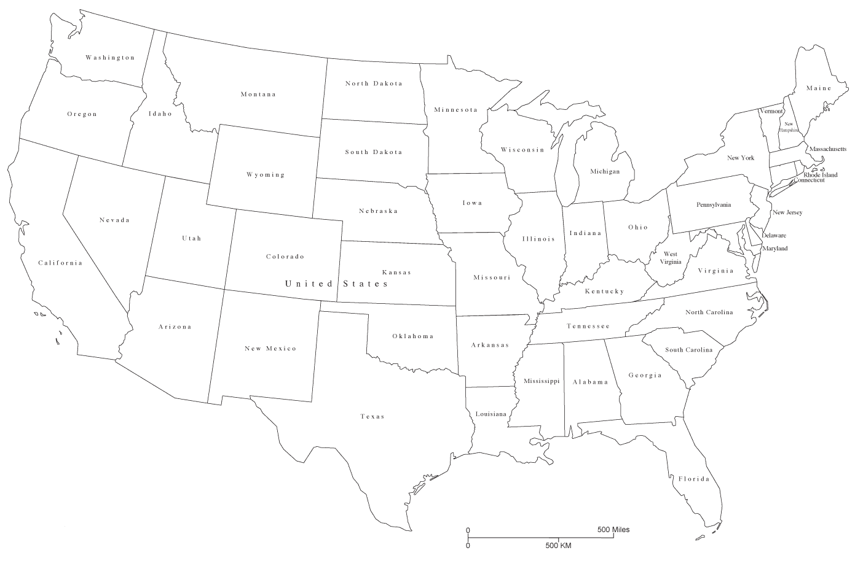






GHAE/BHP: best us location
Best Wind Resources
Texas is Largest US Consumer of Electricity Today at 470,000 GW-Hours, which will Double to 940,000 GW-Hours by 2031.
Best Solar Resources
Highest PPA Electricity Prices
GHAE/BHP Val Verde County TX
TX has Fastest Interconnection
Best Gas Resources
Best Water Resources
Best Location for Manufacturing with Baseload & Renewable PowerGen.
Best Location for Renewable PPAs to the US’ Largest Power Consumers.

Slide 3
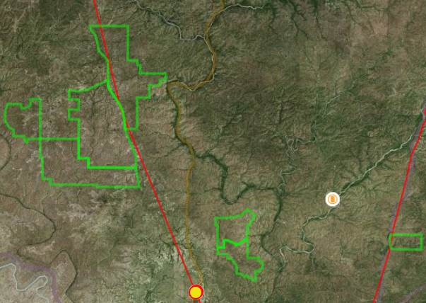
solar & wind power
Blue Valley 2,155 MWac and P90 5,436,545 MWh.
Sister 3,492 MW and P90 8,798,860 MWh.
Brother 2,985 MW and P90 7,528,750 MWh.
Lane/Crane 1,080 MW and P90 7,528,750 MWh.
Upper Rodeo 235 MW and P90 592,630 MWh.
138 kV 480 MW Rated Transmission Line (380 MW Today)
Blue Valley 20,050ac
Sister 26,600ac
138 kV 480 MW Rated Transmission Line (75 MW Today, 155 MW Jan 2027)
Brother 27,100ac
Lane & Crane 12,100ac
North Rodeo 2,500 ac
Conservative Solar Estimates: No Other Design Considerations Applied
Acreage (up to 8% to 15% Slope) times 0.95 for Road Accommodation.
545W Modules on 8% Single-Axis Trackers with Inverter Ratio of 1.32.
P90 Year 2015 Production Runs using NREL System Advisor Modeler.

Slide 4
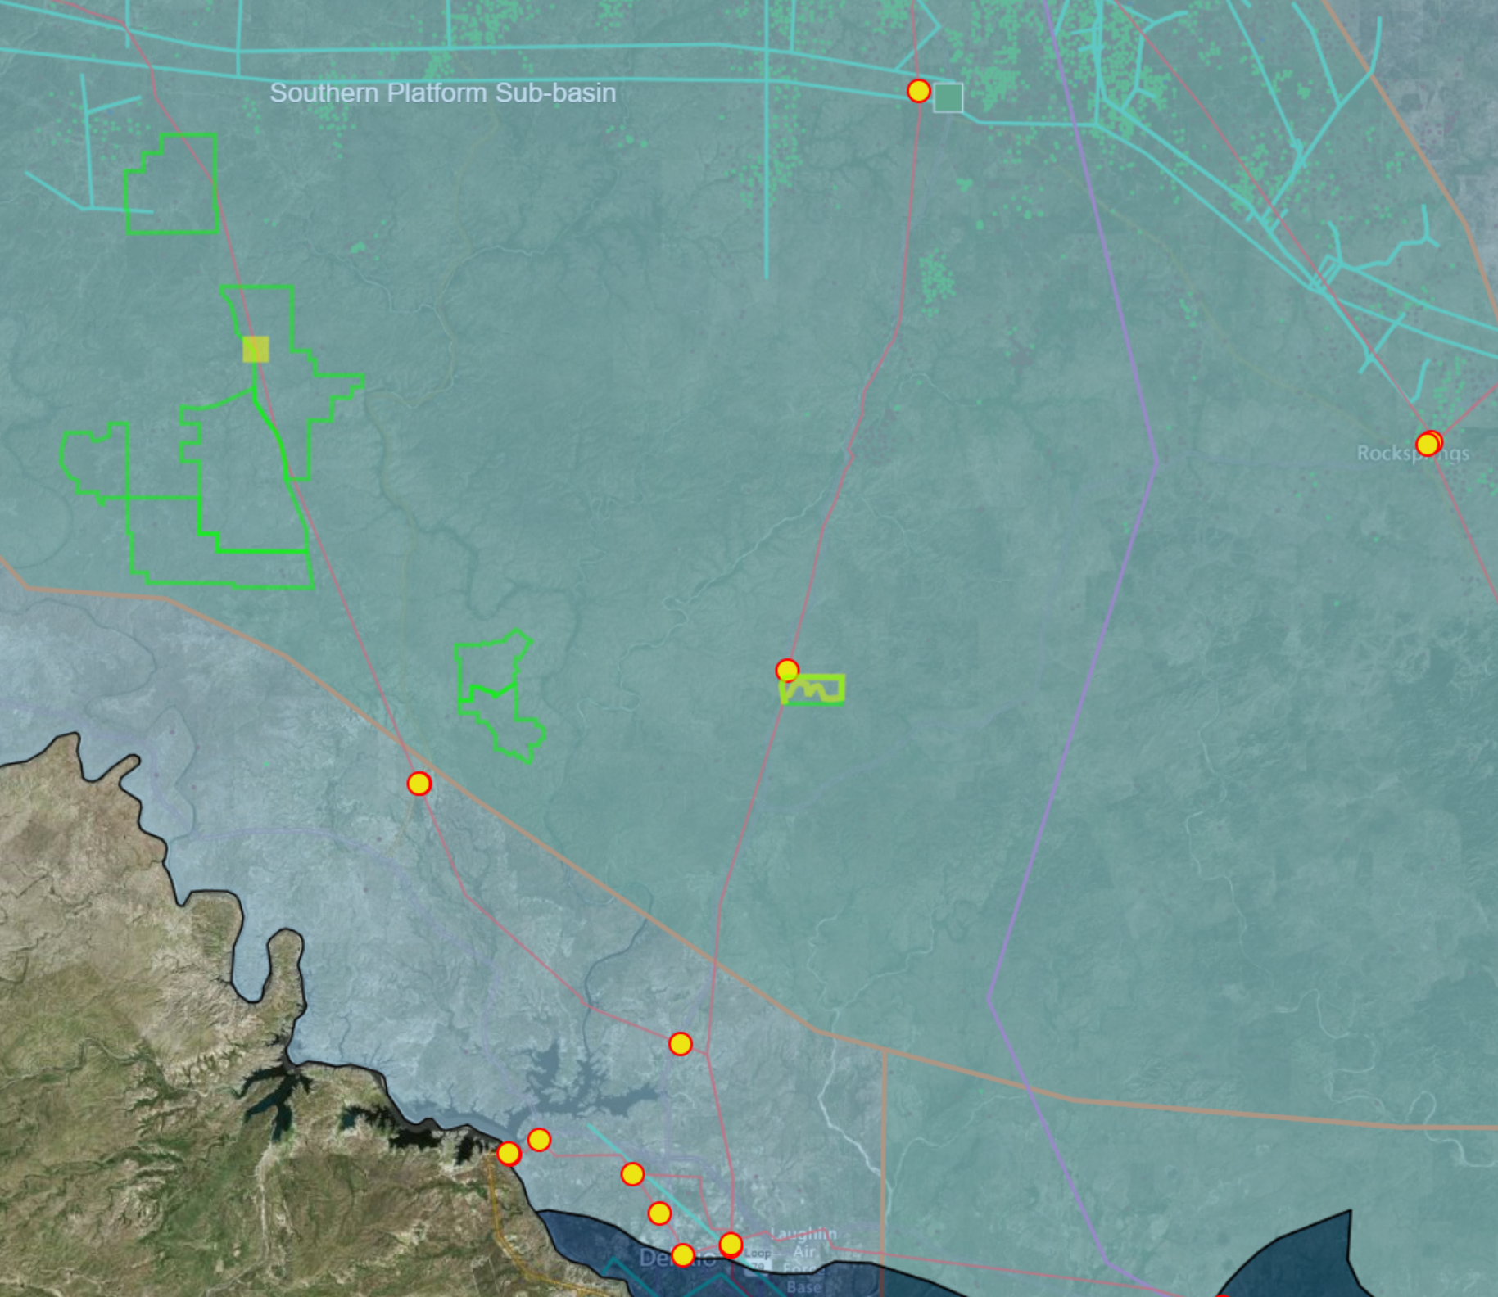
Gas power & Water access
Multiple Natural Gas Pipelines North of Val Verde County.
Multiple Natural Gas Pipelines in Del Rio, TX.
GHAE/BHP Properties lie on Natural Gas Basin.
GHAE/BHP Properties lie on Large Water Aquifer.
Blue Valley 20,050ac
Sister 26,600ac
Brother 27,100ac
Lane & Crane 12,100ac
North Rodeo 2,500 ac
Orange Line represents Boundary of this Natural Gas Basin
Blue Area represents Water Aquifer Boundary
Solar, Wind and Natural Gas Generation with Water can be provided On-Site for 24 by 365 Power Generation with High Renewable Power Content.

Slide 5
GH America Energy
https://GHAmericaEnergy.com
+1 (979) 583-1544
GHAE/BHP Properties Analysis:
Solar, Wind, Natural Gas & Water Resources
PV/BESS Pricing, Connection & Transport Access
Current & Future Power Transmission Access

Slide 6
GH: natural Resources

Slide 7
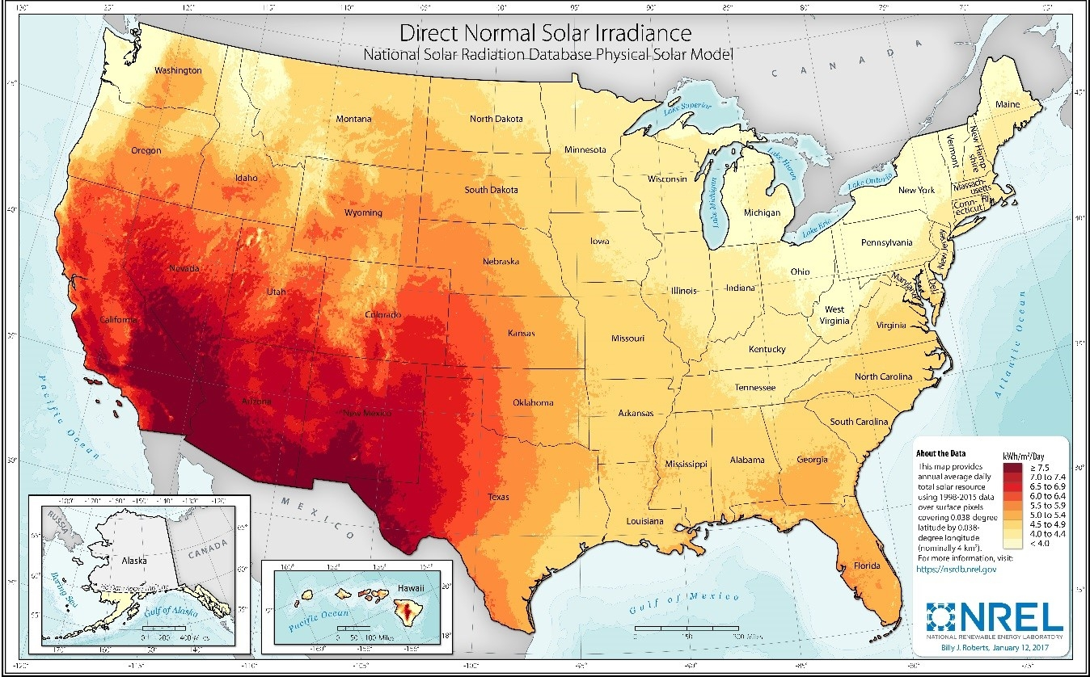
us solar Power Resources
6.5 to 7.5 kWh/m2/day
through Southwest US.
GHAE/BHP within the Best Solar Irradiation in the US.
<10 MW C&I Solar Projects need ½ to 2½ Months to finalize Approvals. It has the fastest renewables USA growth rate of 12%, with IRRs of 14% to 23% for projects completed in less than 12 Months.
>20 MW Utility Solar Projects need 1½ to 3½ Years to finalize Approvals. It has a slowing USA growth rate of 10%, with IRRs of 8% to 14% for projects completed in less than 6 Years.

Slide 8
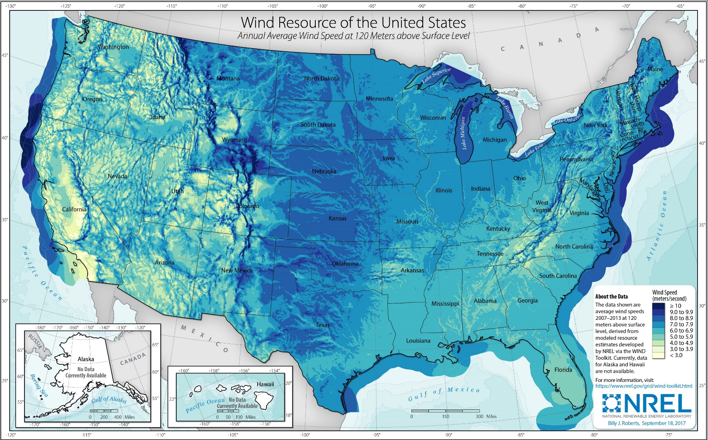
us wIND Power Resources
On-Shore Wind
120m Hub Height Wind Speeds of 7.0 to 8.0 m/s East of Rocky Mtns, within Best Wind Speeds in the US.
GHAE/BHP within the Best Wind Speeds in the US.
On-Shore Wind needs 2 to 3 Years to finalize Approvals. It has a slowing USA growth rate of 8%, with IRRs of 6% to 9% for projects completed in less than 6 Years.

Slide 9
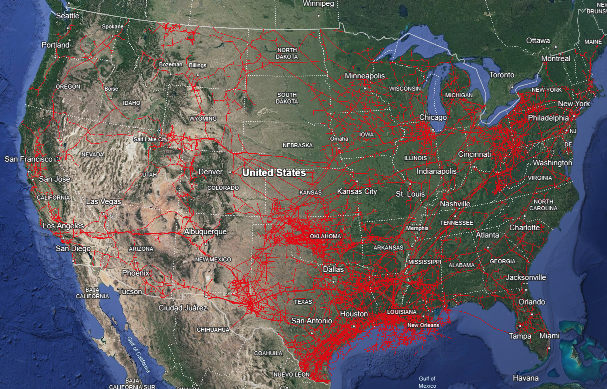
us Gas power Resources
Pipe Concentrations
West of Appalachians
and OK & Texas.
GHAE/BHP within the Best Gas Pipeline System in the US.
Peaking Power Plant
<300 MW Machine Ramps Up to Speed in less than 3 Minutes.
Baseload Power Plant
>400 MW Machine Ramps Up to Speed in Less than 15 Minutes.
<300 MW Peaking Plants need ½ to 1 Year to complete Approvals. It has an annual USA growth rate of 3%, with IRRs of 8% to 12% for projects completed in less than 3 Years.
>500 MW Baseload Plants need 1 to 3 Years to complete Approvals. It has an annual USA growth rate of 5%, with IRRs of 9% to 15% for projects completed in less than 4 Years.

Slide 10
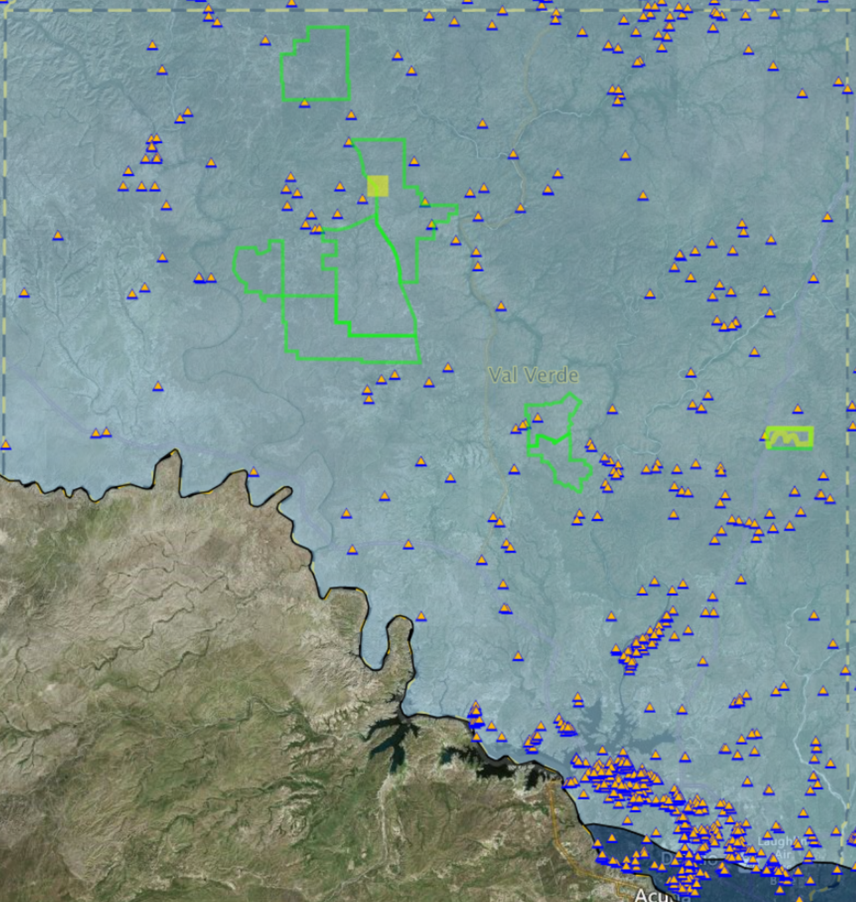
TX WATER Aquifer Resources
Numerous Water Wells are drilled throughout Val Verde County, TX.
The Edwards-Trinity Aquifer extends throughout Middle Central, Texas.
GHAE/BHP within this Large Water Aquifer within Texas.

Slide 11
GH: pv/bess ppa contract
Prices

Slide 12
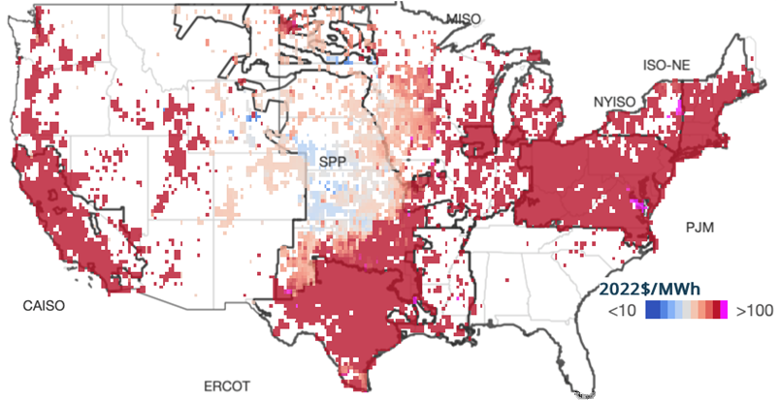
uS pv/bess contract prices
Highest Peak Prices occur in Northwest, CA and Texas.
Highest Peak Price Areas are where to put PV Solar and Energy Storage in Texas, the #2 PV & BESS Markets within the US.
<10 MW C&I BESS needs ½ to 2½ Months to complete Approvals. It has the fastest renewables USA growth rate of 13%, with IRRs of 9% to 21% for projects completed in less than 6 to 12 Months. It is used for facility behind the meter peak demand energy savings.
>20 MW Utility BESS needs ½ to 1½ Years to complete Approvals. It has the fastest renewables USA growth rate of 16%, with IRRs of 10% to 19% for projects completed in less than 3 Years. It is used for utility in front of meter grid frequency & voltage stabilization.

Slide 13
GH: pv/bess connection

Slide 14
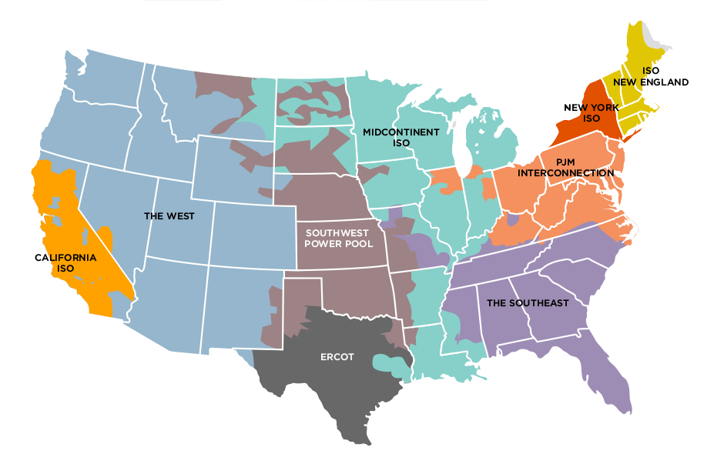
us interconnection ISOs
Independent System Operators (ISOs) regulate Transmission & its Pricing: CAISO, SPP, NEISO, MISO, PJM, NYISO & ERCOT.
WECC (West) & SERC (Southeast) are regional Coordinating Councils of their Utilities.
As of 2022, the US had a transmission capacity of 3,904,546 MVA, which is expected to increase to 3,946,581 MVA by 2028.
However, about 30% of the US’s 642,000 miles of high-voltage transmission lines will need to be replaced in the next decade. And today, much of the substation and transmission bandwidth has been captured by approved and in-queue projects through 2027.

Slide 15
us interconnection ISOs
GHAE/BHP is in ERCOT, which has the Fastest and Most Successful Interconnect Process within the US.
24%
16%
9%
17%
19%
8%
14%
The XX% is Projects that had reached Commercial Operations.
24% of ERCOT TX Projects reached Commercial Operations in 1½ to 2 Yrs.
Only 8% of CAISO CA Projects reached Commercial Operations in 3 to 4 Yrs.

Slide 16
GH: transportation access

Slide 17
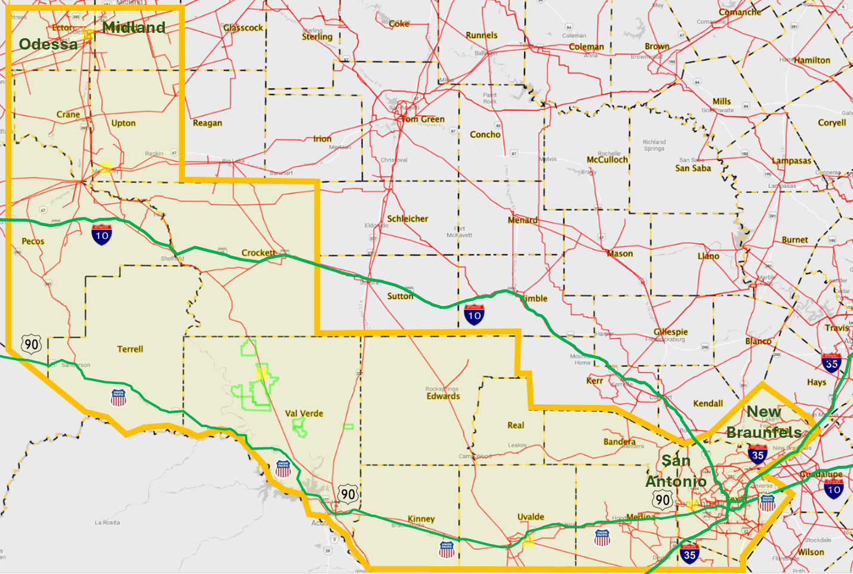
Tx transportation access
Midland, Odessa, New Braunfels, San Antonio (MONS) Region has the Best Transport System in the US.
GHAE/BHP is within the Texas MONS Transport Corridor.
Best Wind Resources
Best Solar Resources
Highest Peak Prices
TX has Fastest Interconnection
Best Gas Resources
GHAE/BHP is served West & East by US I-10, Texas 90W, and Union Pacific Railroad, and is served North & South by US I-35.

Slide 18
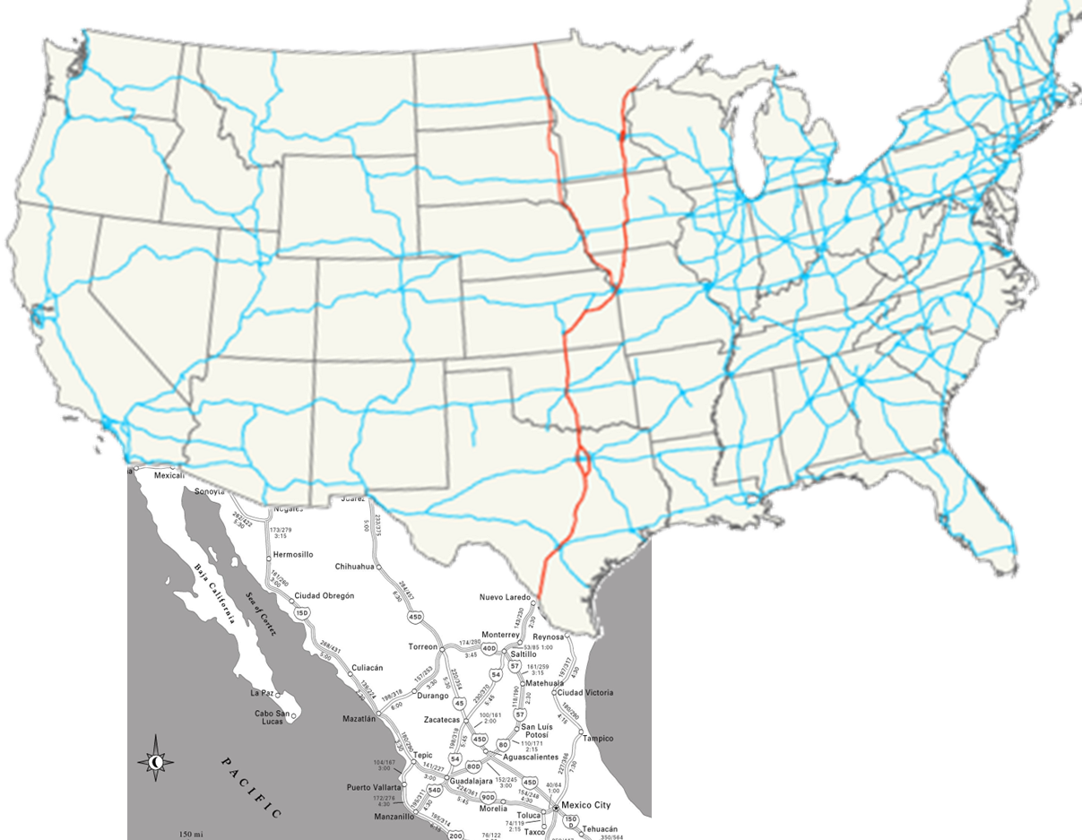

US Transportation access
Trans-Canda Coast to Coast Highway
GHAE/BHP is central to the NAFTA Shipping & Transport System, from US West Coast to US East Coast, from the Trans Canadian Highway, down through the Mexican Fabrication Plants, down to their Ports.
US Great Lakes Ports
US I-29 & I-35 Interstate “NAFTA” SuperHighway
US Western Seaports
US Eastern Seaports
US I-10 Coast to Coast Highway
US Gulf of Mexico Ports
MX Highways to MX Western Seaports
BHP/GHAE in Val Verde County, TX

Slide 19
GH: transmission access

Slide 20
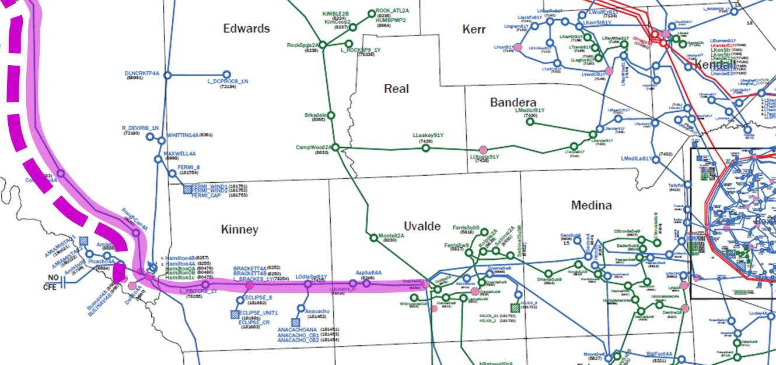
current Transmission
BHP/GHAE in Val Verde County, TX
Solid Pink Line is 138 kV 480 MW Rated Line with 380 MW Available Today, with Projects in Queue potentially reaching SGIA 149 MW Jan and 94 MW Jun.
Dashed Pink Line represents uninstalled 138 kV 480 MW Rated Line that AEP will install to power a Major Load (Manufacturing Plant or Data Center), which then could be fed with combination Baseload and Renewable Power.

Slide 21
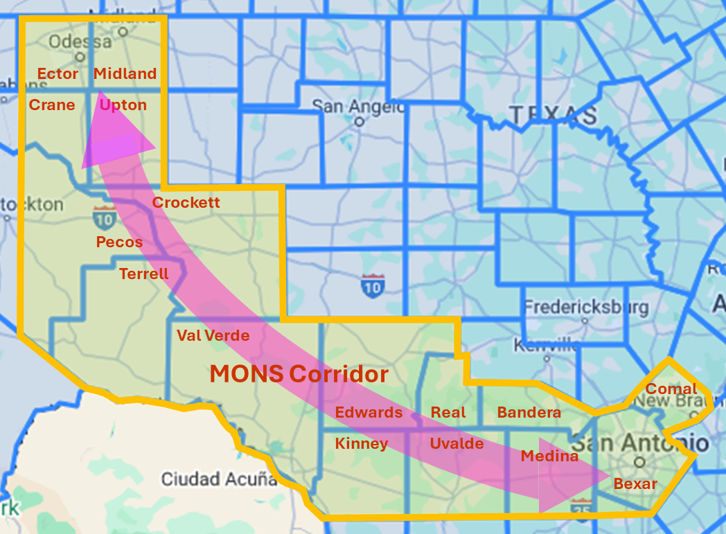
Future Transmission plan
The Midland-Odessa-NewBraunsfel-SanAntonio (MONS) Corridor, a new +30GW Transmission System between Permian Basin and Edwards Plateau to be completed by 2038 for the Largest Electricity Consumers in the US.

Slide 22
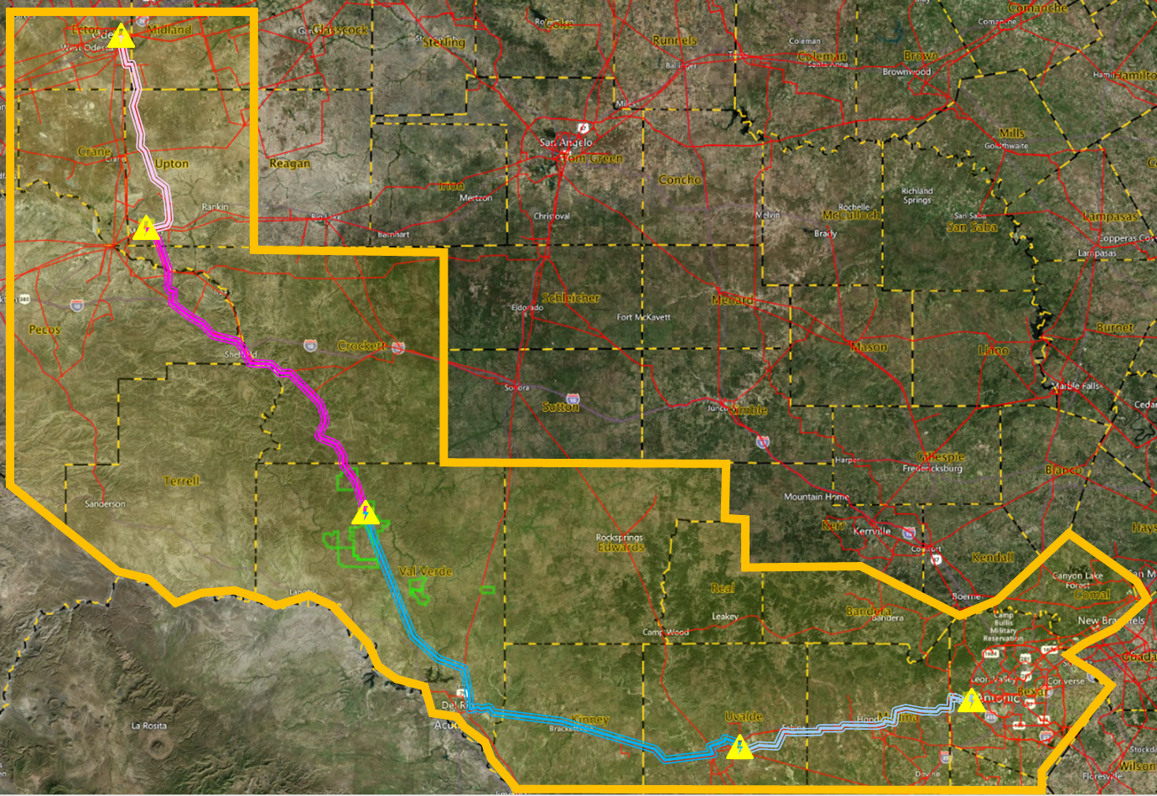
future transmission route
Triple-Odessa Substation & Storage
65 mi 765kV Network Line
Bakersfield / Camey Substation & Storage
Blue Valley Substation for the Renewables PowerGen
Downie Substation & Storage
85 mi 765kV Private Branch
Bandera Substation & Storage
140 mi 765kV Private Branch
70 mi 765kV Network Line
Possible Route between Midland / Odessa and New Braunfels / San Antonio
Best Northward Feed into Bakersfield / Camey / Odessa for Permian Basin.
Best Eastward Feed of Power is into Downie / Bandera for Edwards Plateau.

